Slide 1
XingQiao event managment platform (Tech Prototype)
Vahagn
Simon
2023-05-18

Slide 2
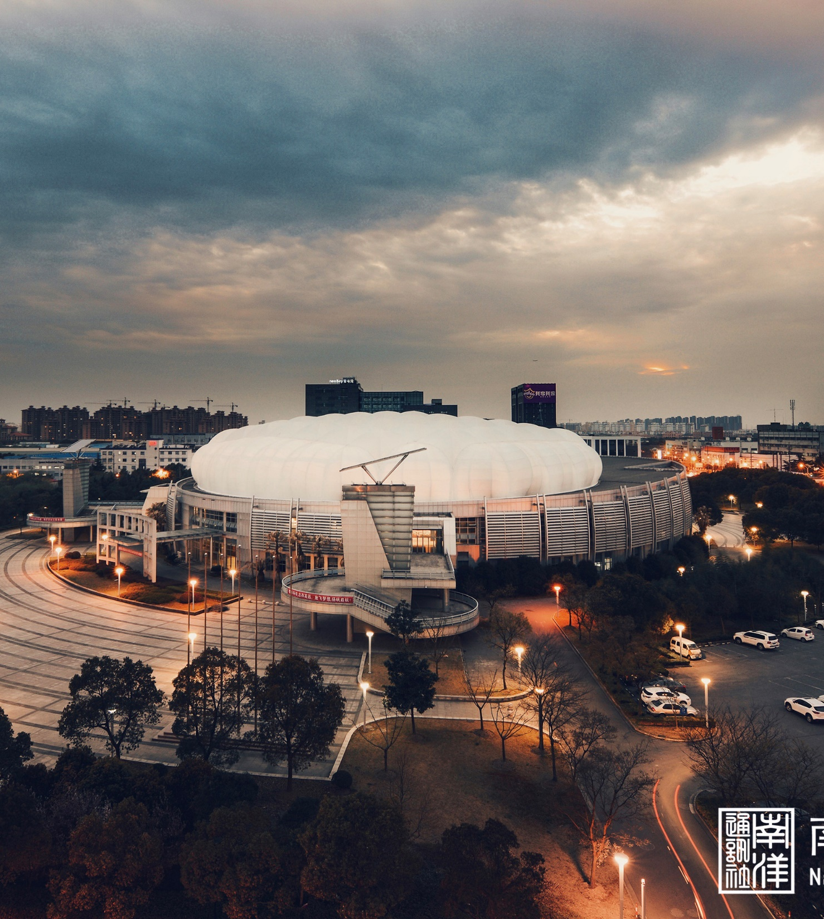
Content
1
Software Architecture
2
Software design
3
Iterative Evaluation Summary

Slide 3
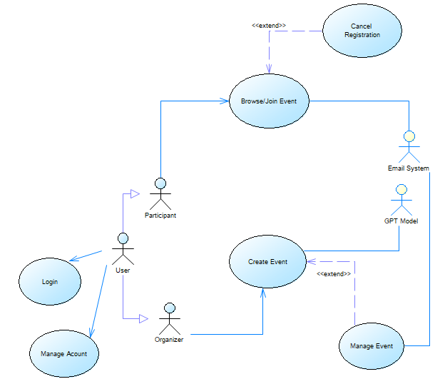
Use Case diagram
Main actors: User, Participant, Organizer
Secondary actors: Email System, GPT Model
Use cases:
- log in
- manage account
- cancel registration
- browse/Join event
- create event
- manage event

Slide 4
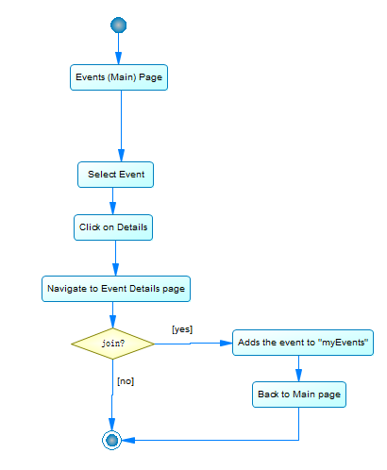
Use Case diagram
Example:
Browse/Join event (Activity diagram)

Slide 5
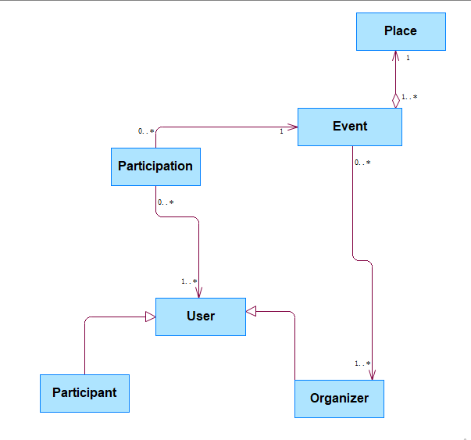
Conceptual Model
Participation class:
Many to Many map for user and Event

Slide 6
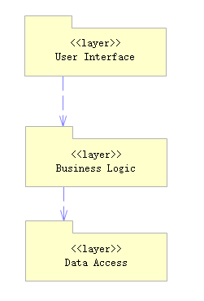
Logic View : 3-tier client-server model

Slide 7
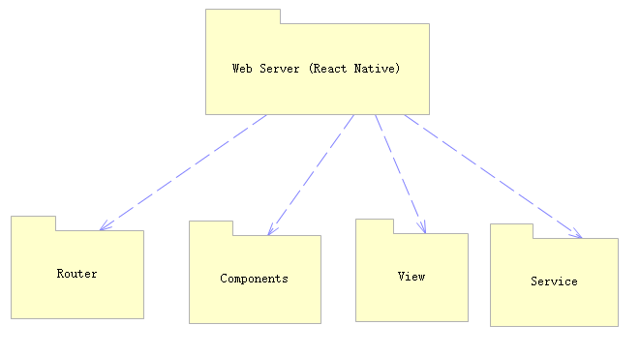
Logic View :
User interface layer

Slide 8
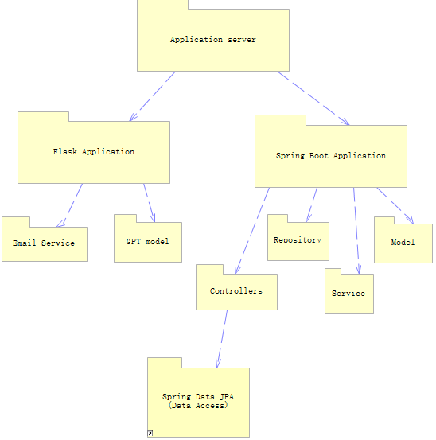
Logic View :
Business logic layer

Slide 9
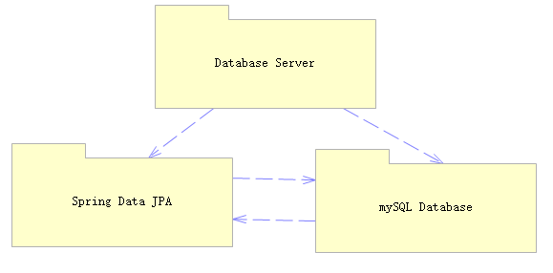
Logic View :
Data access layer

Slide 10
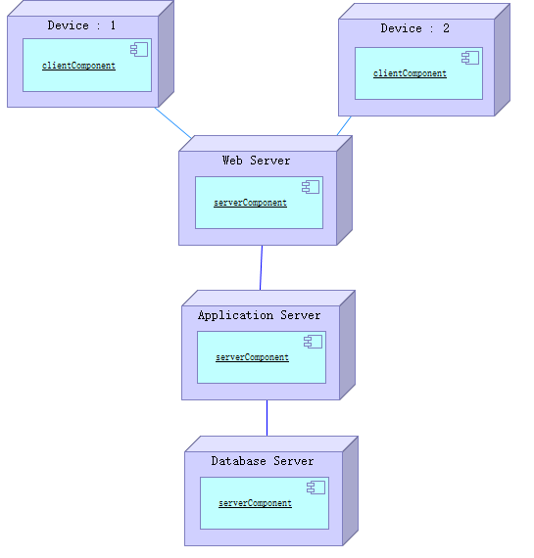
Deployment View
Client
Web Server
Application Server
Database Server

Slide 11
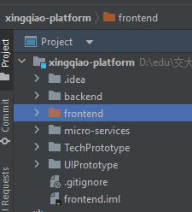
Software design
Structure

Slide 12
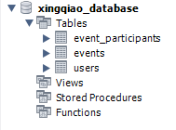
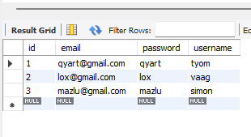
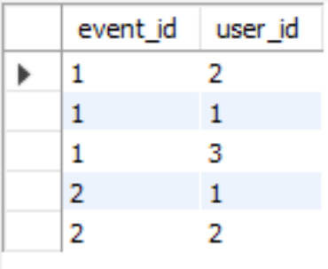
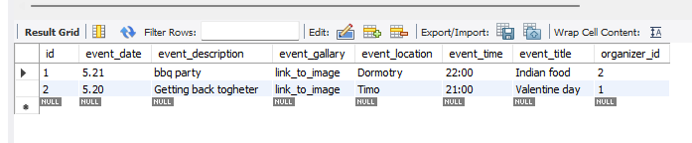
Database Design
Main schema
Users
Participations
Events

Slide 13
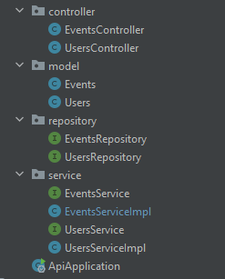
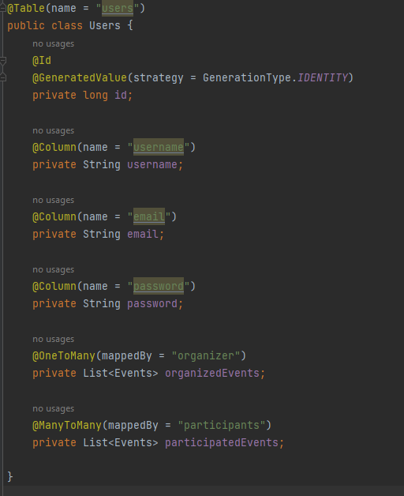
Backend Design
Spring boot
Structure
User class example

Slide 14
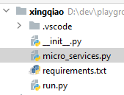
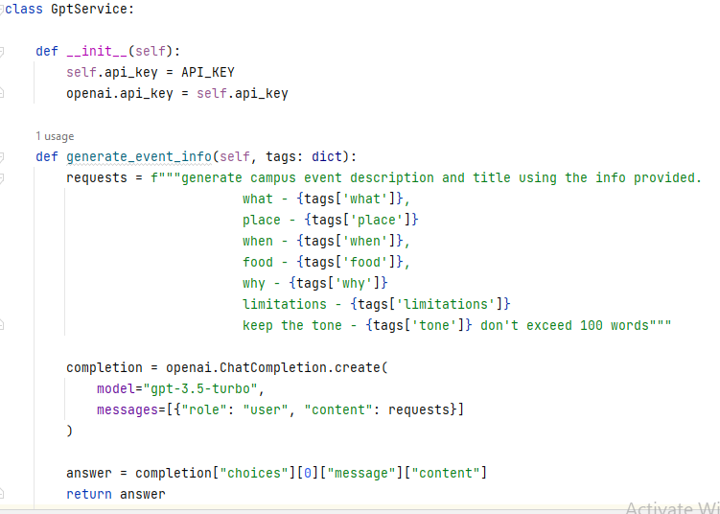
Backend Design
Flask
Structure
GptService class example

Slide 15

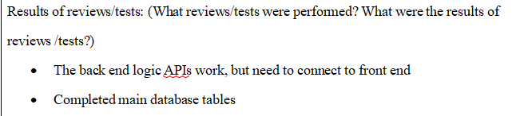
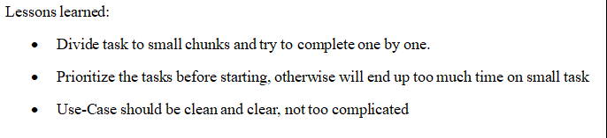
Iterative Evaluation Summary

Slide 16
Thanks!

